Slide 1
INPUT CONTRACT
What goes in: a normalised order
Cartons define the warehouse catalogue. Items define the order. The solver starts only after units, dimensions and masses are normalised.
JSON File: 2 Items
Cartons
{
"order_id": "ORD-77",
"cartons": [{
"sku": "BOX-S",
"inner_dims": [220,160,120],
"tare_mass": 120,
"max_contents_mass": 5000
}],
"items": [
{ "item_ref": "BOOK",
"dims": [200,150,40],
"mass": 800, "quantity": 2 },
{ "item_ref": "PAINT",
"dims": [100,100,120],
"mass": 400,
"dg_class": "3",
"allowed_rotations": "upright" }
]
}
Inner dimensions, tare mass, max contents mass.
Items
Reference, size, mass; quantity expands to separate units.
Portal
kg + item_code
Adapter
mm + grams
Solver
validated units
→
→
Optional constraints
DG class, incompatibility, and allowed rotations.
All input geometry is integer millimetres; all mass is integer grams.
Notes:
One order comes in: carton catalogue plus order items. Portal-specific naming and kilograms are translated first, quantity expands into units, then constraints like dangerous goods and rotation limits are enforced.

Slide 2
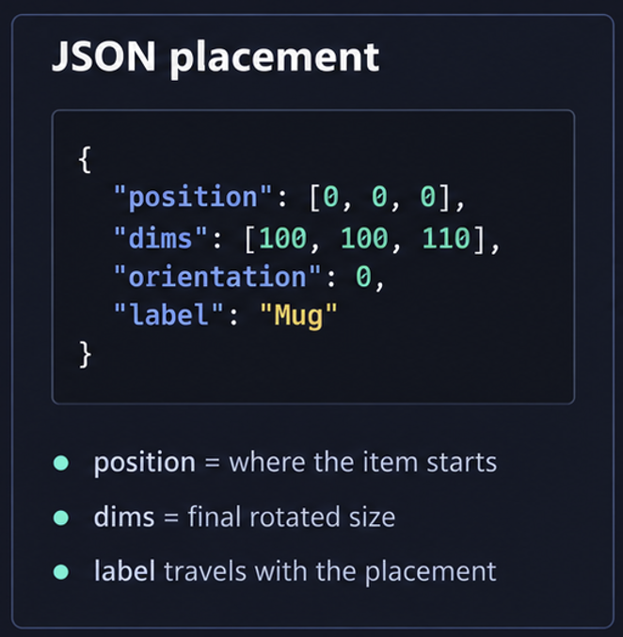
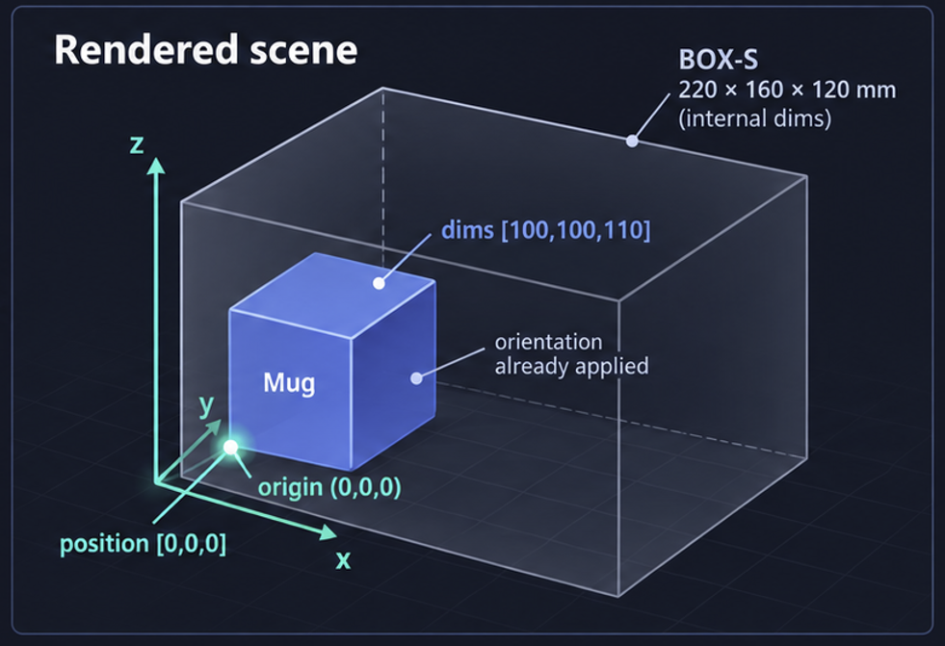
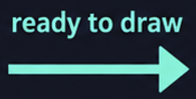
OUTPUT CONTRACT
What comes out: a self-contained scene
The visualiser should not look anything up. Every placement carries the final position, final dimensions and display detail needed to draw the carton.
Renderer rule: Draw the box from position + Dimensions.
No extra math or catalog lookup
Notes:
The response is a complete drawing instruction. It includes coordinate rules, metrics, physical cartons, placements with already-applied rotations, and rejects. That keeps the visualiser simple and makes partial success explicit.

Slide 3
VALIDATION BEHAVIOUR
What gets refused: two failure paths
The contract separates a broken request from a bad item. One stops the solve; the other is recorded and the rest of the order still packs.
HTTP 422
order refused
↗
Request
Validate
→
↘
HTTP 200
pack what can fit
Visualise placed
+ list rejects
→
Order refused
Item dropped
Everything else packs
No cartons · no items · invalid carton dimensions · time budget < 1 ms
INVALID_DIMENSIONS · MISSING_MASS · NO_FITTING_CARTON
DG split · incompatible pairs separated · upright/fixed rotation preserved · deterministic layout
Broken order = error. Broken item = reject entry.
This keeps the warehouse moving: partial success is a normal result, not a crash.
Notes:
The key distinction is validation level. If the order itself is broken, nothing is packed and the API returns 422. If one item is broken or cannot fit, the solver returns 200 with placements plus reject reasons.

